Slide 1
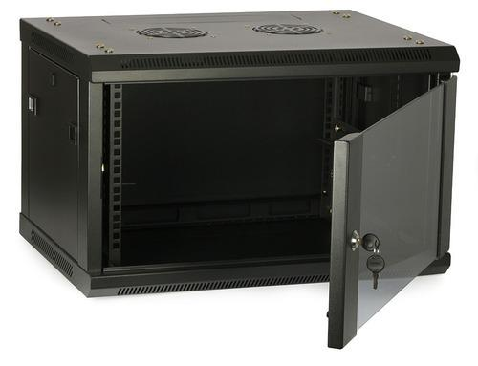

Calabanga
L.H.S
Fisheries
Library
Science
Education
I.C.T
CHDC
Multi Media
2nd flr
G. flr
Fiber optic cable
CoE Faculty
Fiber optic cable
Fiber optic cable
CoED
Guard House
Multi Purpose
Fiber optic Redundant
Cat 6A Backbone
Fiber optic cable
Fiber optic cable
R.O.C.O
Cat 6A Access point
Access point
Data Cabinet
Supply
Social Hall
B.A.C
Fiber optic cable
Canteen
Trade
Hostel
Admin
CIT computer
Automotive

